Slide 1
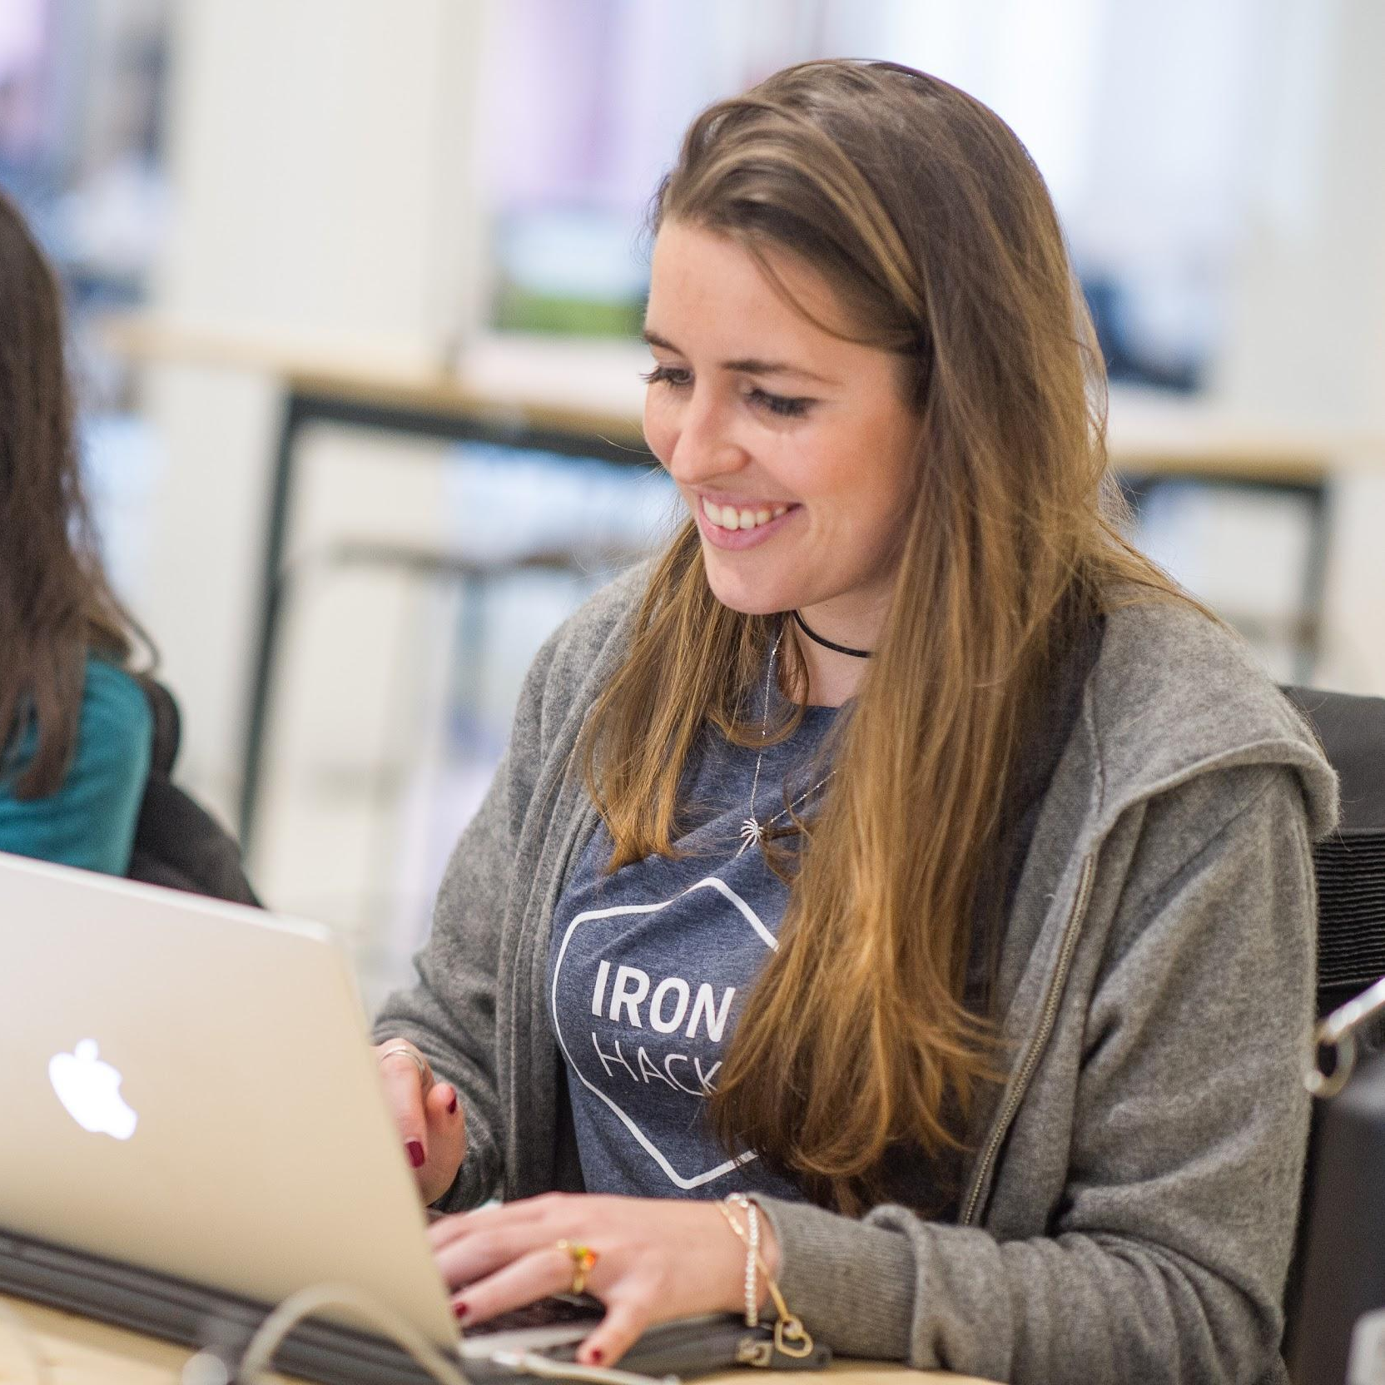
Intro to Machine Learning
YOUR COURSE NAME | IRONHACK

Slide 2



IRONHACK BOOTCAMP
Agenda
Machine Learning
Supervised Learning
Unsupervised Learning
Credit: Unsplash

Slide 3
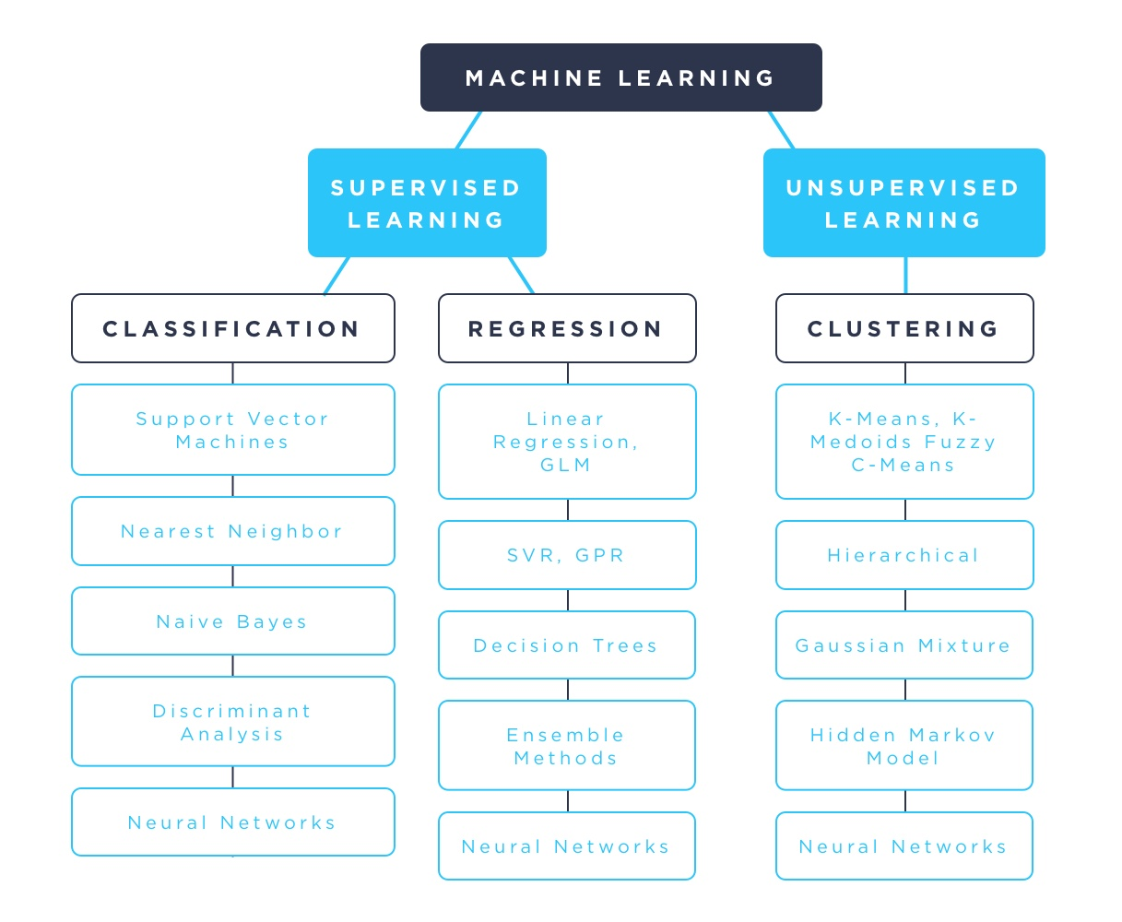
IRONHACK BOOTCAMP

Slide 4

Supervised Learning.

Slide 5
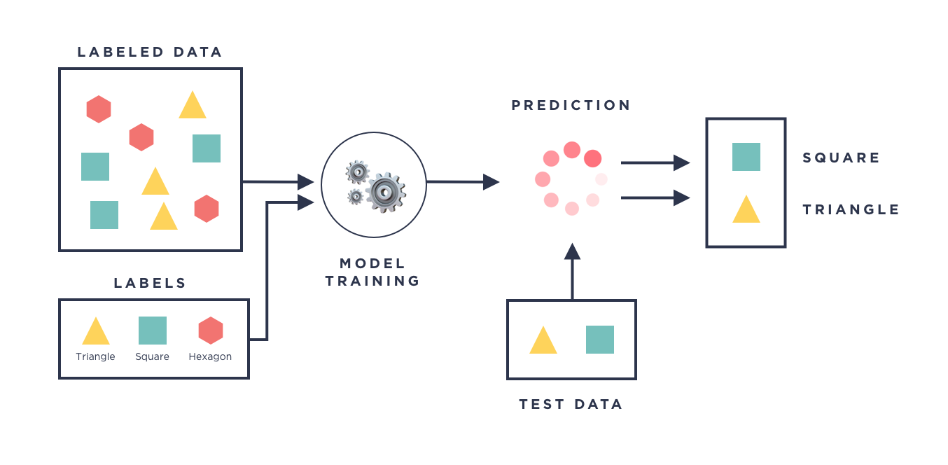
IRONHACK BOOTCAMP

Slide 6
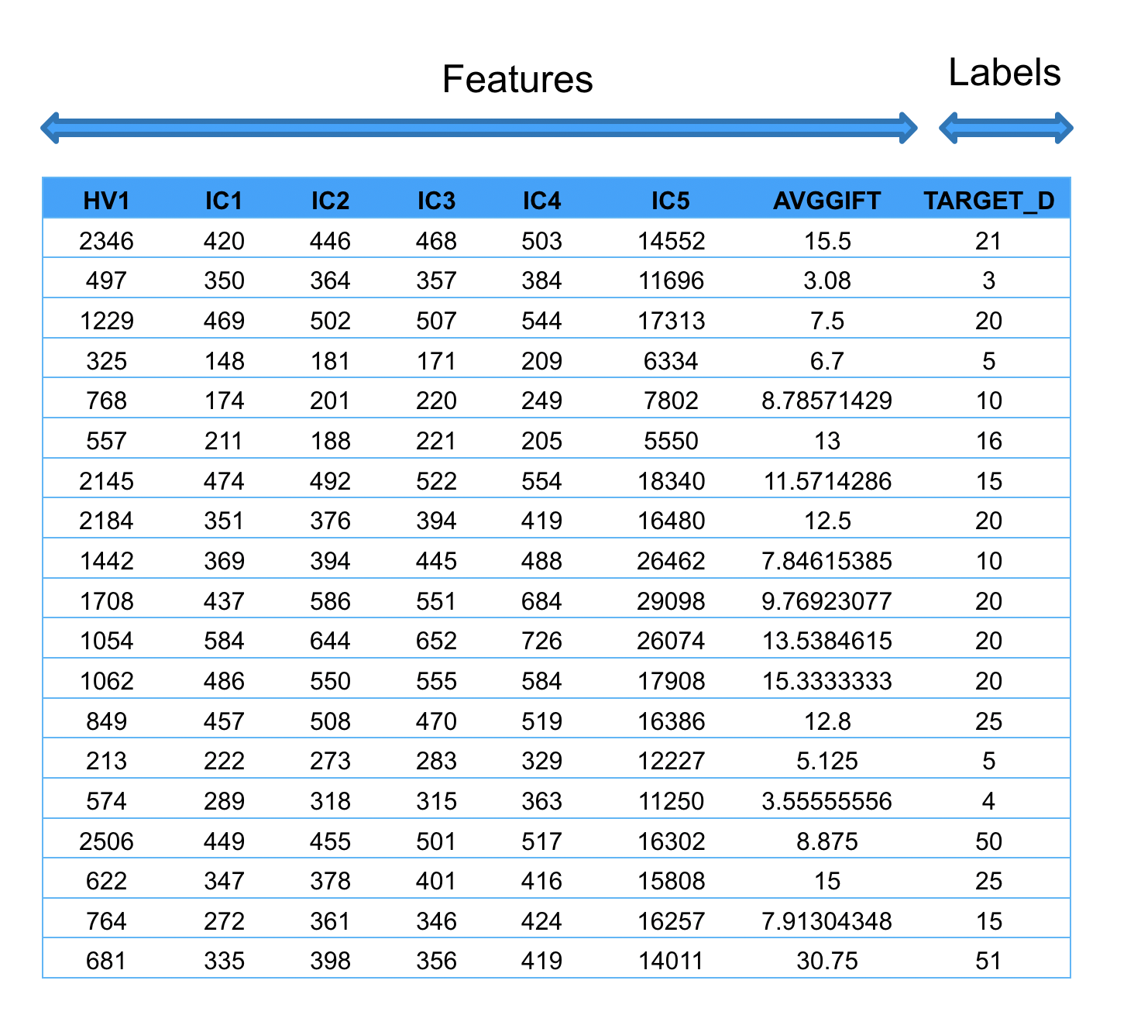
IRONHACK BOOTCAMP

Slide 7
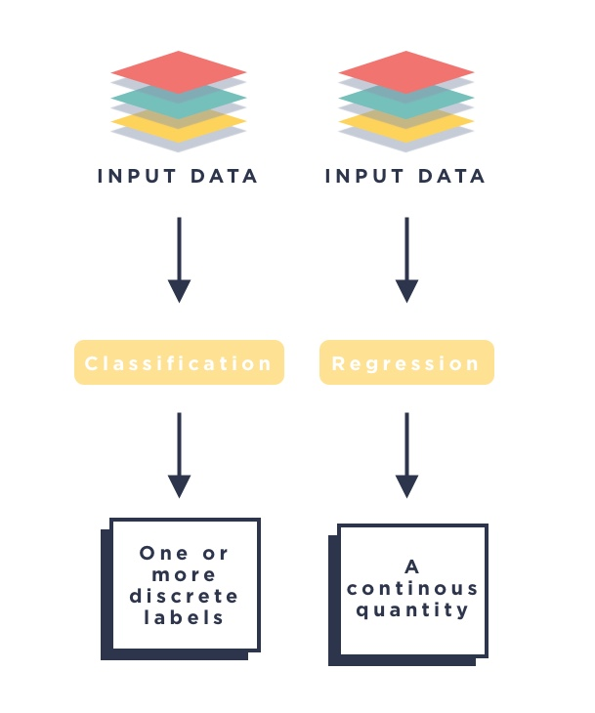
IRONHACK BOOTCAMP

Slide 8
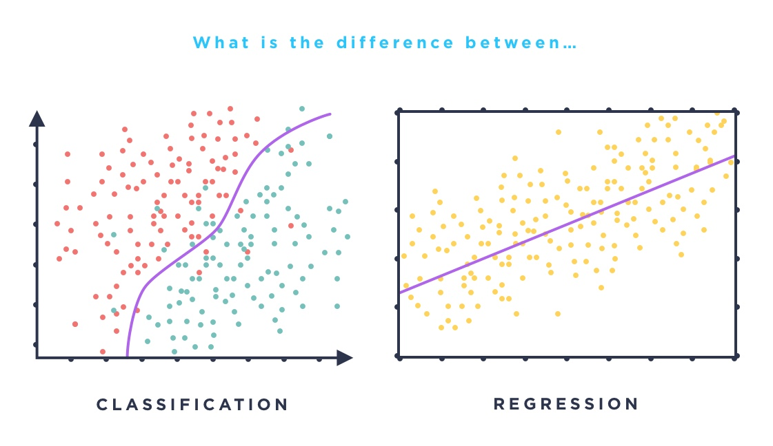
IRONHACK BOOTCAMP

Slide 9
Unsupervised Learning.

Slide 10
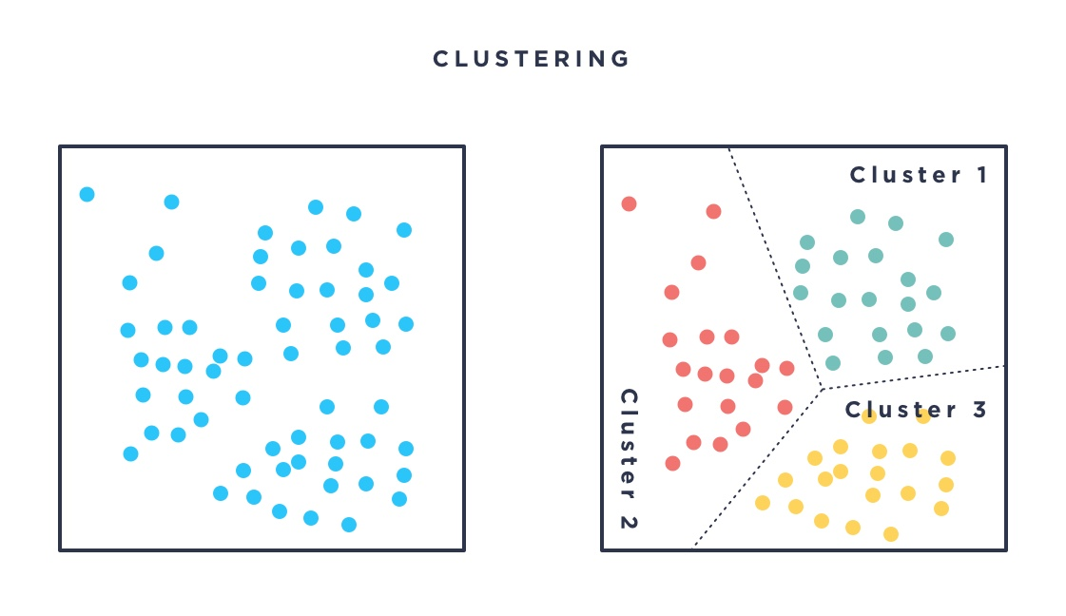
IRONHACK BOOTCAMP

Slide 11
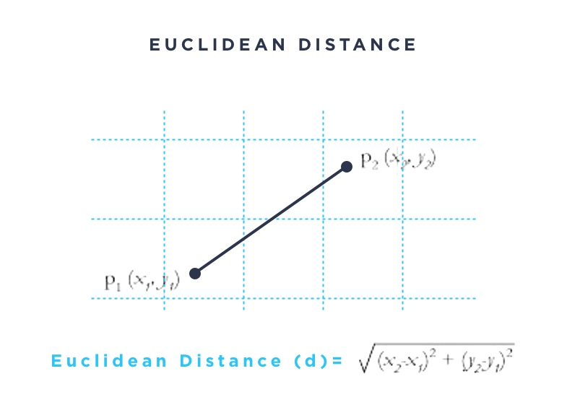
IRONHACK BOOTCAMP

Slide 12
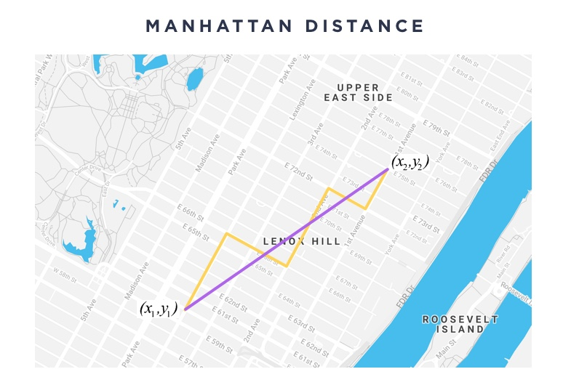
IRONHACK BOOTCAMP

Slide 13
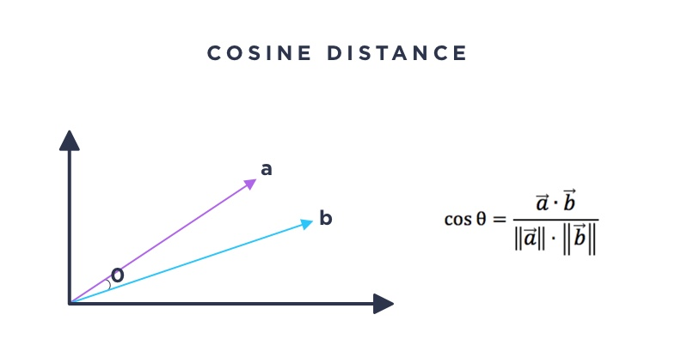
IRONHACK BOOTCAMP

Slide 14
SUMMARY
The name Of the lesson
This is the body text 14pt
Bacon ipsum dolor amet
Chuck bacon doner short
Loin venison andouille
Frankfurter jerky picanha
Frankfurter short loin ham
This is the body text 14pt
Bacon ipsum dolor amet
Chuck bacon doner short
Loin venison andouille
Frankfurter jerky picanha
Frankfurter short loin ham

Slide 15


